Slide 1
Machine Learning Supervised Learning Artificial Neural Network (ANN)-A
Instructor: Zainab Yousuf

Slide 2
Content
Introduction
Artificial Neural Networks (ANN)
Single Perceptron ANN vs Multiple Perceptron ANN
Linearly Separable vs. Non-linearly separable problems
In Next Lecture (B)
Learning process of supervised ANN
Example

Slide 3
Introduction
There are many algorithms in AI which are inspired from biological phenomena. Artificial Neural networks (ANN) is one of them.
ANN (also called “perceptron”) have been around since 1940 and got much attention in last few decades.
Artificial Neural networks (ANN) are inspired from human brain system.
It tends to adopt the human learning behavior in machines
It tries to find the recognition pattern for both Classification problems and regression problems.

Slide 4
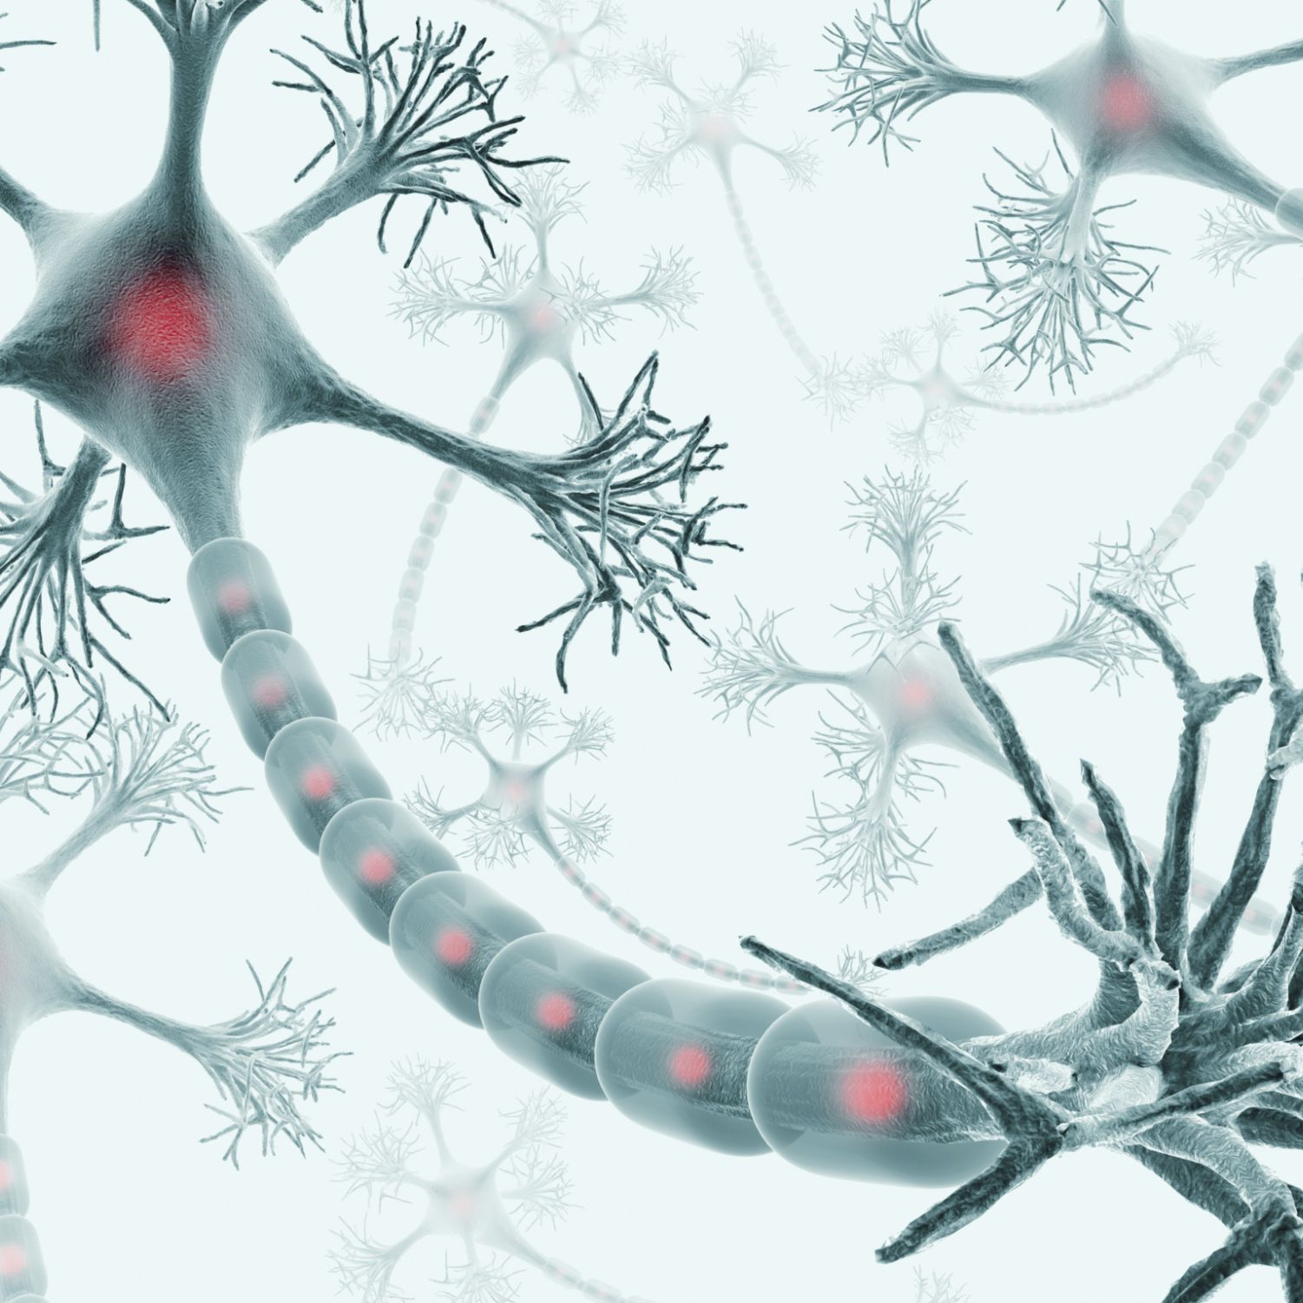
Introduction (Cont..)
Human brain system is comprises of multiple cells, called neuron
Neurons of human brain system are connected with each other, thus it forms the network of neurons.
A neuron cell comprises of
A cell body
Dendrites (1,000 to 10,000)
An axon
Synapse
Each element has its own function

Slide 5
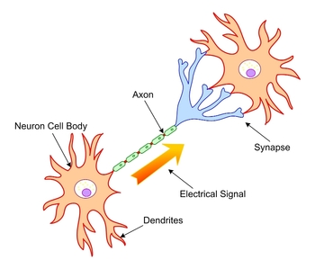
Introduction (Cont.)
Structure of a Neuron Cell

Slide 6
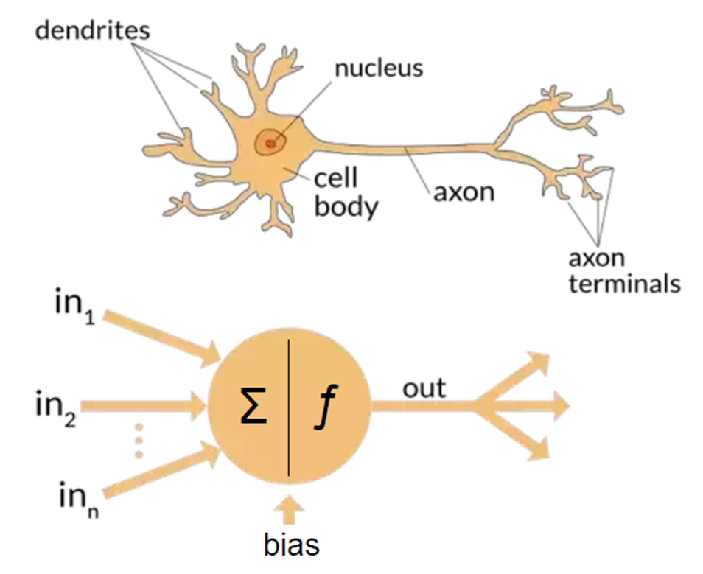
Artificial Neural Networks (ANN)
To capture the essence of biological neural systems, an artificial neuron can be represented as:
https://towardsdatascience.com/

Slide 7
Artificial Neural Networks (ANN)
An ANN is based on a collection of connected units, nodes called artificial neurons or perceptron
Artificial Neural Networks resembles the brain in two respects:
Knowledge is acquired by the network through a learning process (called training; supervised or unsupervised)
Interneuron connection strengths, known as synaptic weights, are used to store the knowledge
Knowledge in the artificial neural networks is implicit and distributed
Knowledge is primarily encoded in the weights of the neurons within the network
ANN can be comprised of single layer or multiple layers of perceptron

Slide 8
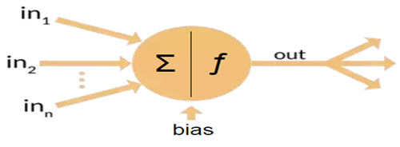
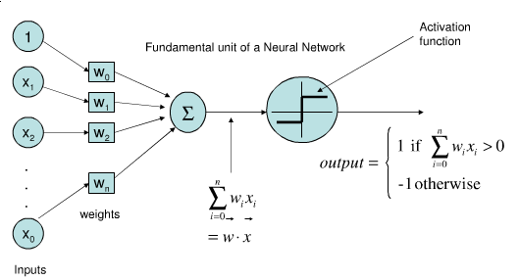
Artificial Neural Networks (ANN)
To capture the essence of biological neural systems, an artificial neuron can be represented as:
https://www.researchgate.net/figure/Single-Layer-Perceptron-Network-Multilayer-Perceptron-Network-These-type-of-feed-forward_fig2_283339701

Slide 9
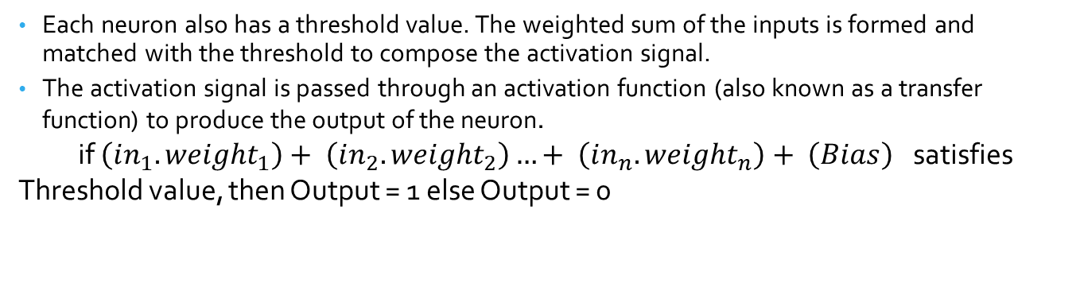
Artificial Neuron or Perceptron
It receives a number of inputs (either from original data, or from the output of other neurons in the neural network).
Each input comes via a connection that has a weight which is also known as the strength of the connection.
Each neuron also has a threshold value. The weighted sum of the inputs is formed and matched with the threshold to compose the activation signal.
The activation signal is passed through an activation function (also known as a transfer function) to produce the output of the neuron.
if $\left(in_{1}. weight_{1}\right)+ \left(in_{2}. weight_{2}\right)…+ \left(in_{n}. weight_{n}\right)+ \left(Bias\right)$ satisfies Threshold value, then Output = 1 else Output = 0

Slide 10
Single Layer vs. Multi Layer Perceptron
Single Layer Perceptron
Multi Layer Perceptron
Can perform pattern classification only on linearly separable patterns e.g.
AND gate
OR Gate
Is used for complex problems which require multiple decision lines for a good acceptable solution e.g. XOR gate
Multiple layer perceptron achieve this task by the introduction of one or more hidden layers.
Each neuron in the hidden layer is responsible for a different line. Together they form a classification for the given problem

Slide 11
Single Layer vs. Multi Layer Perceptron
Single Layer Perceptron
Multi Layer Perceptron

Slide 12

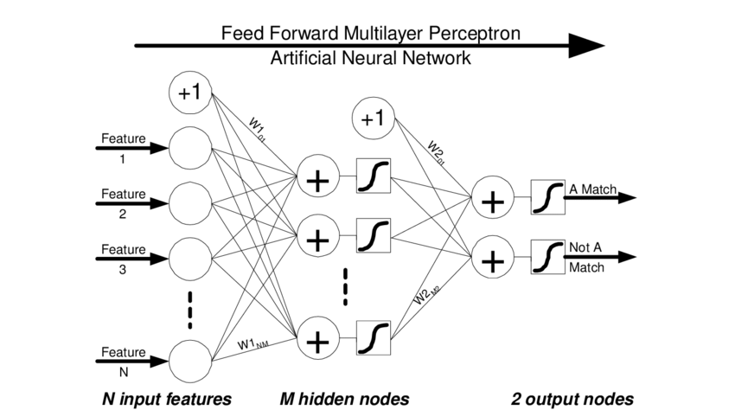
Single Layer vs. Multi Layer Perceptron
Single Layer Perceptron
Multi Layer Perceptron
https://www.researchgate.net/figure/Single-Layer-Perceptron-Network-Multilayer-Perceptron-Network-These-type-of-feed-forward_fig2_283339701
https://www.researchgate.net/figure/The-feed-forward-multilayer-perceptron-artificial-neural-network-architecture-used-to_fig1_221226040

Slide 13
Linearly Separable vs. Non Linearly Separable
Linearly separable problems
Non Linearly separable problems
Linearly separable
Any two sets of inputs are linearly separable if there exists one straight line in the plane with all the values of one set lie on one side of the line and all the values of other set lie on the other side of the line.
Linearly separable problems
Represents those problems whose input can be classify using a straight line.
The simplest examples are the logical AND or OR gate. We can draw them in to 2D input spaces
Non Linearly separable
Any two sets of inputs are non linearly separable if there may not exists a single straight line in the plane to clearly separate the input data
Non Linearly separable problems
The data for these problems cannot be separated into their respective classes by using a single straight line

Slide 14
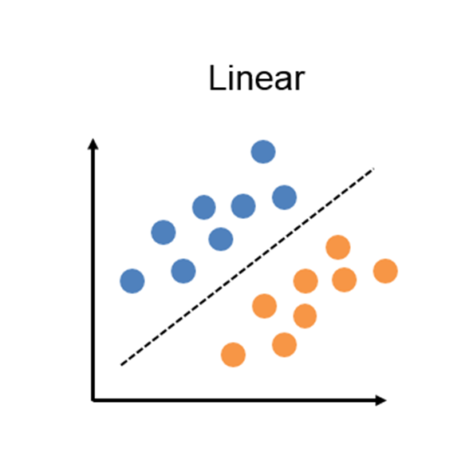
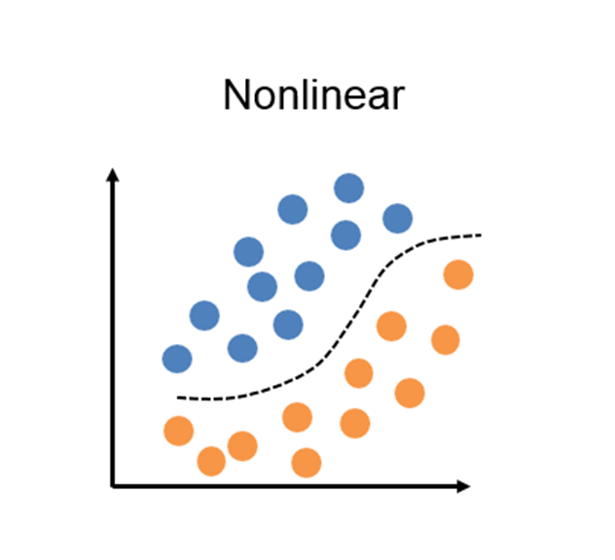
Linearly Separable vs. Non Linearly Separable

Slide 15
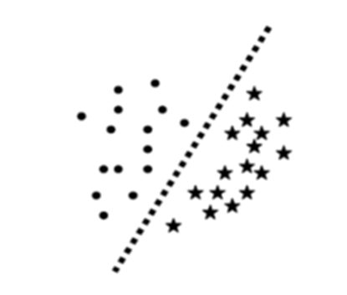
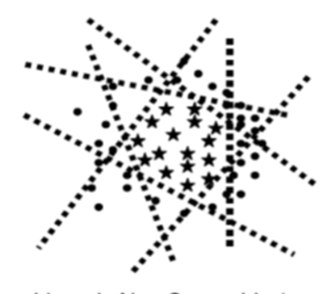
Linearly Separable vs. Non Linearly Separable
Linearly separable problems
Non Linearly separable problems

Slide 16
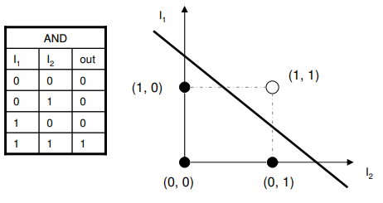
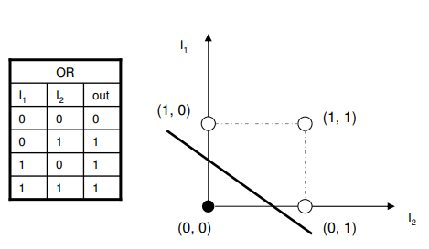
Example : Linearly separable problems

Slide 17
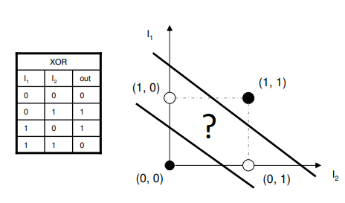
Example : Non Linearly separable problems/ Complex problems

Slide 18
Thank You

